Slide 1
The right book, to the right child, at the right time
Notes:
Welcome & introduction
Click on the SRP logo to launch the 2 min intro video
The video is here in case the link breaks - SRP_Introduction

Slide 2
The three principles of Reading Pro
Notes:
Explain the three principles that Reading Pro is based on:
Assessment: children take a formal reading test three or four times per year. Ideally September, January and after Easter. The fourth would be at the end of the summer term so that you can see progression from the start of term to the end. Any more than four times in a year (there’s a temptation to do a test every half-term
Information: once the children have finished taking their reading test, the information is passed – real-time – to the teacher who can look at it by class, and by pupil to identify where children can improve
Development: Children are recommended the right book at the right time to ensure that their reading progresses as well as it possibly can

Slide 3
Children take an adaptive reading test
Lara King
Notes:
The first time a child logs into Reading Pro, they are asked to take a Reading Pro Test. This test is adaptive, starting at the child’s chronological age and getting harder if they get answers correct and easier if they get them wrong.
The test is made up of 20 questions taken from a bank of over 4000 carefully measured questions taken from real books. Children don’t need to have any knowledge of the book, as the test is based on that paragraph.
The questions only test the child’s literal comprehension skills, not inference, visualisation etc.

Slide 4
Sample Child Reading Pro Test Performance
Notes:
This is how the test works. The child starts at their chronological age, in this case a child in year 2. You can see from the graph that the questions get harder very quickly in the first section (between question 2 and 3 it is nearly 100L increase) until the child gets their first question incorrect at number 7 (orange bars are incorrect answers). It then becomes a more gradual increase in complexity and you can see in the third section the questions are getting only slightly harder each time and on question 21, the child has gained a score of 620L.

Slide 5
Lara King
Notes:
The child is given their Lexile score – in this case Lara scored 620L and she then goes to create her reading list

Slide 6
Notes:
In order to create a reading list, Lara needs to select one of the interest categories. This screenshot from the video only shows 9 interests, but there are really 24. They also change depending on the age of the child from ‘In the Past’ to ‘Historical stories’ and ‘Funny stories’ to ‘Humour’ for example.
At this point, it is worth us taking of stock of what Reading Pro knows about the pupil:
It knows the age of Lara
It knows how well Lara can read
It knows what Lara likes to read.
And now it can recommend Lara the best books to read

Slide 7
Three children in Year 4
(expected Lexile at end of Year 4 = 700)
480L
700L
880L
Notes:
I’ve taken the three children in the video we watched at the start of this session and assumed that they are all in year four, but that they are all reading at different levels.
So, the child in the middle is our ‘average’ child – the one who is a proficient reader and reading at their expected level.
The child on the left is reading two years behind their chronological age, so a Year four child working at the level of a year two reader – this child is a Basic reader
And the child on the right is working two years ahead of their chronological age, so a year four child working at year six level – this child is an Advanced reader

Slide 8
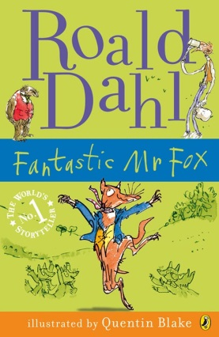
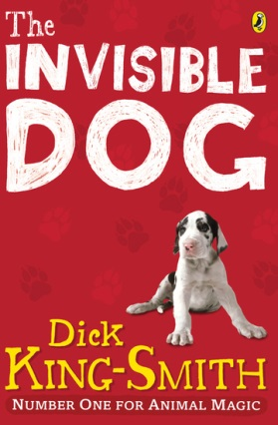
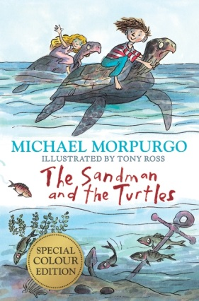
700L
600L
700L
750L
Notes:
This pupil is in year four, has a Lexile score of 700 and has selected interest categories including Animals and Pets. Amongst others, the books that will be recommended will be:
The Invisible Dog by Dick-King Smith which is spot on her 700L score
Roald Dahl’s Fantastic Mr Fox at the lower end of the scale (remembering that the scale goes 100L below her score and 50L above)
And The Sandman & The Turtles by Michael Morpurgo at the top end.
All three of these books are perfect for her chronological age, and reading age, and all will keep her reading progression going at the correct pace

Slide 9
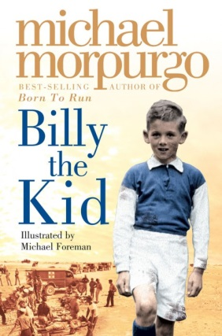
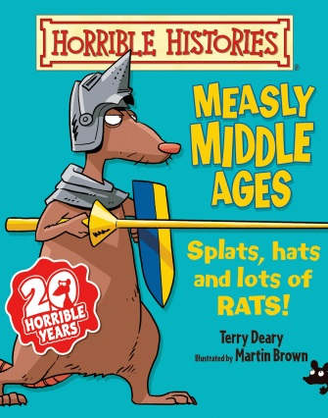
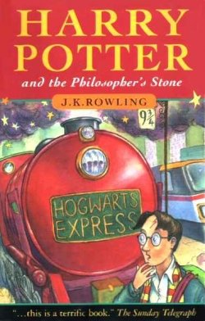
880L
780L
880L
930L
Notes:
Finally, this pupil is in year four, has a Lexile score of 880 and has selected interest categories including Friends, family & Growing up, In the past and Action & Adventure. Amongst others, the books that will be recommended will be:
Harry Potter and the Philosophers Stone which is perfect for their level
Billy the Kid, by Michael Morpurgo at the lower end of the scale and
The Measly Middle Ages, a non-fiction history title at the top end of the scale

Slide 10
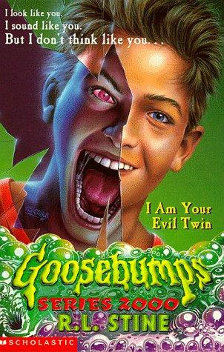
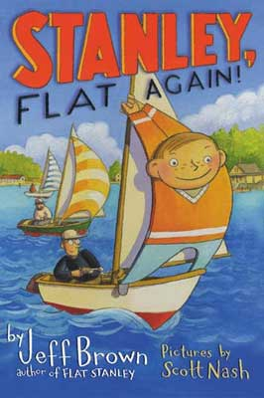
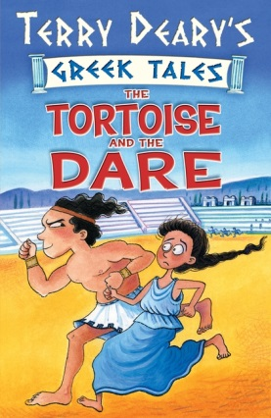
480L
380L
480L
530L
Notes:
This pupil is in year four, has a Lexile score of 480 and has selected interest categories including Friends, family & Growing up. Amongst others, the books that will be recommended will be:
Stanley, Flat Again by Jeff Brown, which is spot-on for their level
The Tortoise & The Dare, by Terry Deary at the top end of the scale and
Goosebumps – I am your evil twin at the bottom end. This book is the one that exemplifies exactly how Reading Pro works. All of the books are ideal for the year four child, but could be read by a year two child. However, this book would never be recommended to a child in year two as it would give them nightmares for a week!

Slide 11
Notes:
After choosing a book, the child reads it, then logs back into the system in order to take a quiz based on the book. They are given ten questions based on the book, and they need to get seven correct in order to pass the quiz.
Note: the quiz score does not affect the pupil’s Lexile score. The benefit for taking a quiz, is that it gives the teacher information about whether the child has understood the book; and it gives the child motivation to earn points towards their next reading certificate.

Slide 12
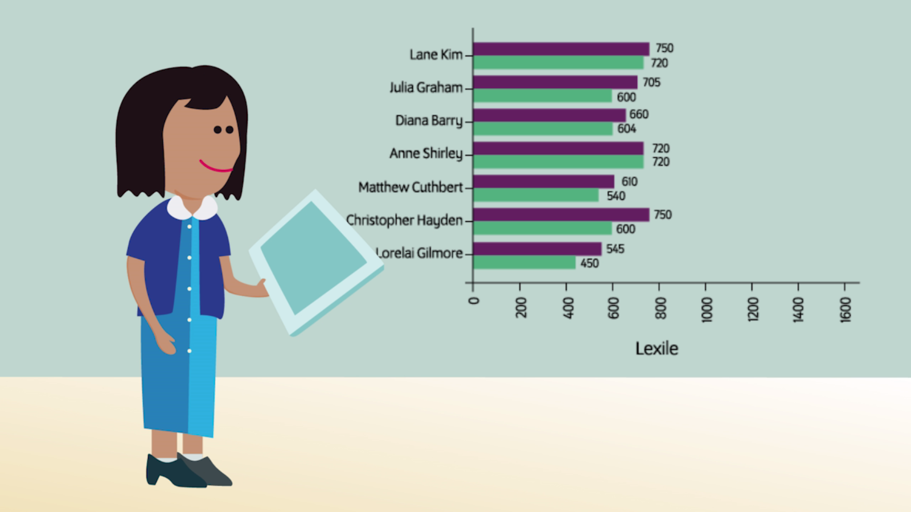
Notes:
The reporting in Scholastic Reading Pro is very simple, but very powerful. The data here is a screenshot from the video, and will never be as simple as this, but even at this level, we can start to see that there are some stories to be told…
First, you need to know that the green bar is the first reading test the child took, and the purple is the most-recent test.
Therefore, you can look at Christopher Hayden and see that in the first test he was a 600L and he has increased his score by 150L, which is very good progress.
You can look at a child like Anne though, who was one of the top two readers in the class, and her Lexile score hasn’t improved at all between the two tests.
This data can give you a really good starting point for asking questions, and we’ll go into this in more detail later on.

Slide 13
Pupils who read more, achieve more
Notes:
Pupils who read more, achieve more. That was the basis for the Read Every Day campaign that Scholastic were part of in 2013; and is backed up by research from all over the world, including here in the UK.
The bit that is very important though, is if you can keep the child in their Lexile scale whilst reading, you can ensure that their reading progression is improving at its optimum pace.

Slide 14
Notes:
To recap.
The child takes a reading test
They get their Lexile score
They choose their interest levels
They read one of the recommended books
They take a quiz based on that book
They go back to 4) until their teacher tells them to take another reading test, whereupon they start again at 1)
All the time this is going on, the pupil’s reading level increases, and the teacher has lots of data to analyse!

Slide 15
How many quizzes are there in Reading Pro?
Quizzes for over 12,100 books…
From over 360 different publishers and imprints including:
Penguin (Roald Dahl, Diary of a Wimpy Kid)
Harper Collins (David Walliams, Divergent, Tiger Who Came to Tea)
Orchard (Beast Quest)
Scholastic (Hunger Games, Julia Donaldson, Horrible Histories)

Slide 16
How were the books selected?
The book selection came from:
Best-selling books in the UK – eg David Walliams, Diary of a Wimpy Kid
Classic children’s books – eg Little Women
The latest children’s books
Books that may be out of print, but that we know schools have purchased for their libraries.

Slide 18
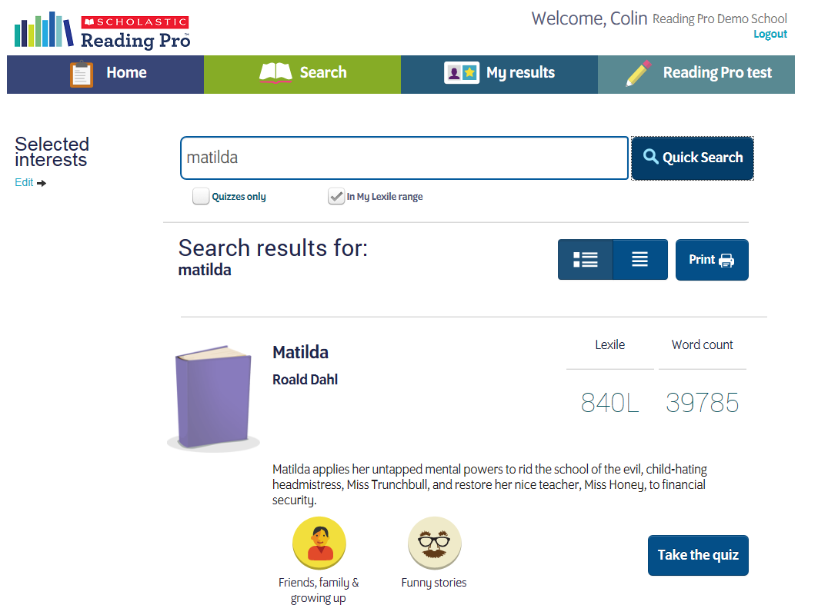

Slide 19
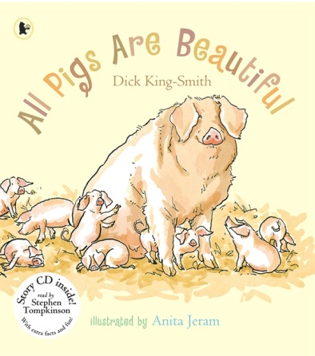
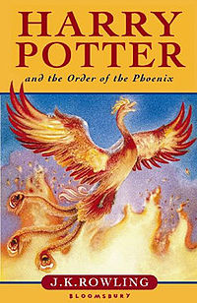
“My child has been sent home with a picture book…”
Book and author | All Pigs are Beautiful Dick King Smith | Harry Potter and the Order of the Phoenix J K Rowling
Lexile Level | 890L | 950L
Number of Words | 834 | 224,522
Age recommendation | Ages 5-7 | Ages 9-11

Slide 20
What do the codes mean?
Lexiles usually are shown by a number followed by ‘L’, eg. 450L.
However there are some codes that you may notice:
AD: Adult Directed – books that are usually read to a child
NC: Non-Conforming – often non-fiction books appropriate for a range of ages
HL: High-Low – books at a high interest level, and lower reading ability
IG: Illustrated Guide – encyclopaedia's, books with technical vocabulary etc.
GN: Graphic Novel – very highly illustrated fiction books, or comic books
NP: Non-Prose – Books with very few words

Slide 21
At the end of the day, it is all about getting children reading:
“Reading Pro really is ahead of the game…since the introduction of this scheme into our school our children have gained, or realised, their real love for reading. An Ofsted inspector commented on how favourably the children speak about reading and that they enjoy it and could speak well about their book and a range of others.”
Rachel Manley, Deputy Headteacher, Cotsford Junior School

Slide 22
Questions
For more information visit www.scholastic.co.uk/readingpro

Slide 23
Thank you

