Slide 1
Attendance Policy 2024-25
Guide for Parents & Carers
What do I need to know?

Slide 2
Attendance Policy 2024-25
Why is attendance important?
Academic Achievement
Regular attendance has a positive impact on children’s academic achievements.
Academic Progress
By not attending school children will miss out on key concepts (including phonics or mathematical procedures). These gaps in knowledge
hamper future progress.
Mental Health
Anxieties are reduced when children know routines and feel confident in accessing the content of the lessons.
Missing days of school disrupts routines and also creates gaps that are difficult to fill as lessons move on. This can cause increased anxieties and a feeling of not being good enough.
Wellbeing
A sense of belonging to the school community helps you to feel safe and secure.
Friendships
Having friends is important for everyone. When children are out of school regularly or for prolonged periods of time friendship circles can
change – which can
cause problems when
the absentee returns!

Slide 3
Attendance Policy 2024-25
What do all the words mean?
Authorised Absence (this list is not limited to):
An absence for sickness
Medical or dental appointments which unavoidably fall during school time
Religious or cultural observances for days set aside by a religious body, for which the school has granted leave
An absence due to a family emergency, taken with the school’s permission
Unauthorised absence (this list is not limited to):
Parents/carers keeping children off school unnecessarily or without reason
Truancy during the school day
Absences which have not been properly explained
Arrival at school after the close of registration
Absence due to unofficial responsibilities at home
Absence due to birthdays
Absence due to term-time trips and holidays that have not been authorised by the school
Persistent absenteeism:
Missing 10 percent or more of schooling across the
year for any reason
Severe absenteeism:
Missing 50 percent or more of schooling across the year for any reason

Slide 4
Attendance Policy 2024-25
What do I do each day, and when?
Doors open/Start of the day
End of the day
All children:
8:40am
3:10pm
Children have a
‘soft start’ to the day.
When the doors open at 8:40am children will come inro school and carry out some fluency tasks to recap previous learning and practice key skills.
The school doors will be closed at 9am. Any children arriving at school after the doors have closed will need to come in via the front office and sign in as late.
Pupils attending after 9:30am
will receive a mark to show
that they were on site, but this
will count as a late mark.

Slide 5
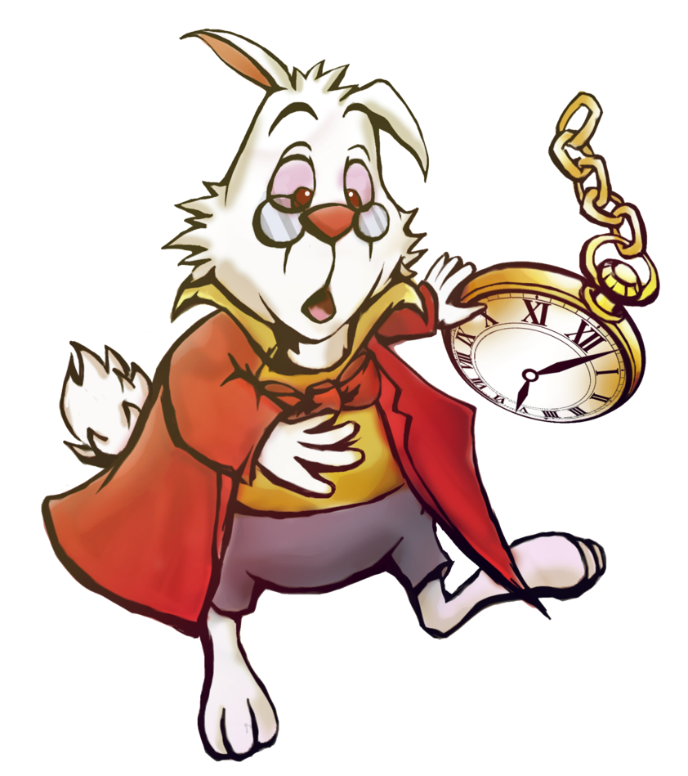
Attendance Policy 2024-25
Why does being on time for school matter?
Coming into class late, when the rest of their peers have already started their learning could make your child feel quite anxious.
If your child is late everyday they will miss a chunk of the first lesson – this will put them behind their peers and mean they may miss out on
key information
required in the rest of
the lesson.
If children are not
picked up on time at the
end of the school day, the teacher will take them to the front office and office staff will phone parents/ guardians.
If you know you are
going to be late for pick-up it would be helpful if you contact the school on 01273 605700 so we can let your child know and alleviate any worries they may have.

Slide 6
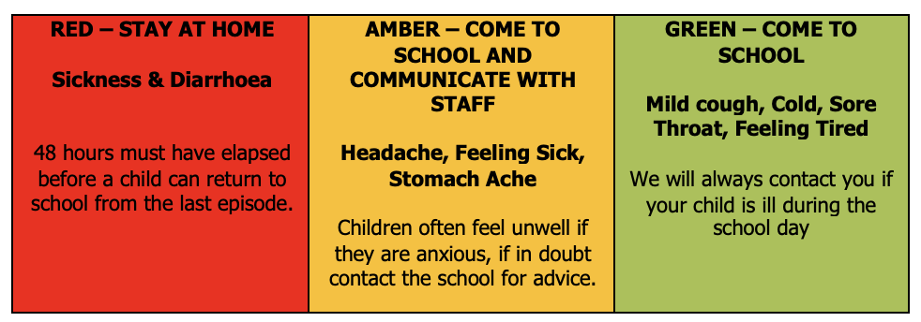
Attendance Policy 2024-25
When is my child too ill for school?
Children do get ill which does mean they may need to have a few days off school. We are aware however that sometimes children are missing school when they could be in the building. The traffic light guidance above will help you decide if your child is well enough to come into school. If your child is having a regular, reoccurring medical issue please let us know. We could get the school nurse involved and hopefully address your child’s medical needs and improve their attendance.

Slide 7
Attendance Policy 2024-25
What do I do if my child needs a medical appointment?
We request that, where possible, routine medical and dentist appointments are arranged outside school hours as these appointments will affect your child’s learning, and percentage attendance.
We do understand that some appointments, such as hospital consultations are not always possible to arrange outside of school hours. However, if your appointment time allows your child to come to school for registration and then leave later this will have a positive impact on their attendance. Likewise, if they are able to be back in school after their appointment this will also have a positive impact.

Slide 8
Attendance Policy 2024-25
Can I take my child on holiday during term-time?
The DfE statutory guidance states that “Generally, the DfE does not consider a need or desire for a holiday or other absence for the purpose of leisure and recreation, to be an exceptional circumstance.” It also states that “a school cannot grant leave of absence retrospectively.”
The school will require parents to observe the school holidays as prescribed; therefore, the headteacher will be unable to authorise holidays during term-time in most cases. The headteacher will be only allowed to grant a leave of absence in exceptional circumstances. Applications will be made in advance.
Any leave of absence is at the discretion of the headteacher. Any requests for leave during term-time will be considered on an individual basis and the pupil’s previous attendance record will be taken into account.

Slide 9
Attendance Policy 2024-25
What are ‘exceptional circumstances’?
Serious or terminal illness of a close relative.
Significant family trauma has occurred and it is believed that a break is in the child’s best interests.
A major family event such as the wedding of an immediate family member
Service personnel returning from/scheduled to embark upon a tour of duty abroad.
Where it is company/organisational policy for an employee to take leave at a specified time in the year and there is no opportunity for a family holiday in school holidays.

Slide 10
Attendance Policy 2024-25
What are ‘exceptional circumstances’?
For term-time absence to be granted:
Permission must be requested at least two weeks before the absence begins.
Permission must be requested by the parent/carer who the pupil normally lives with.
A parent/carer must explain in writing/by completing a Leave of Absence request form why they believe the circumstances to be exceptional and provide all necessary evidence to the school at the time the request is made
We fully understand that it is cheaper to go on holiday during term time but as a school we can only authorise an absence during term time in exceptional circumstances. A cheap deal is not deemed an exceptional circumstance.
Requests for leave will not be granted in the following circumstances:
Immediately before and during assessment periods
When a pupil’s attendance record shows any unauthorised absence
Where a pupil’s authorised absence record is already above 10 percent for any reason

Slide 11
Attendance Policy 2024-25
When will I get fined or prosecuted?
The national threshold for triggering a Fixed Penalty Notice is met when a pupil has been recorded as having had unauthorised absence for 10 or more sessions (5 or more school days) in a period of 10 school weeks. One or a combination of the following codes count as unauthorised absence:
G-codes (unauthorised term-time holiday); N-codes (no reason yet provided for absence); O-codes (poor attendance); U-codes (lateness after close of registration)
1st FINE is… | 2nd FINE is… | 3rd PENALTY is…
£160 per parent/carer per child | issued to parent/carer within a period of 3 school years, the fine is £160 per parent/carer per child to be paid within 28 days and there is no reduction if paid within 21 days. | cannot be issued to the same parent/carer in respect of the same child, within 3 years of the first fine being issued. In a case where the national threshold is met for a third time (or subsequent times) within those 3 years, alternative action could be taken, such as prosecution.
There is no right of appeal once a Fixed Penalty Notice is issued, so disputes over how an absence is classified must be settled with the school before the absence is taken. Full details relating to Fixed Penalty Notice amounts and thresholds can be found in the Code of Conduct on the Brighton & Hove City Council website.

Slide 12
Attendance Policy 2024-25
What are this year’s term dates?

Slide 13
Attendance Policy 2024-25
Help! Who can I talk to about attendance?
If you are having difficulty getting your child into school please talk to us so we can try and work out a plan to overcome whatever barrier is causing the problem.
Adam Sutton
Lynn Tiltman
Lucy Dean
Contact the headteacher via the school office:
01273 605700
office@moulsecoomb.brighton-hove.sch.uk
Contact the Special Needs Co-ordinator on:
01273 605700
office@moulsecoomb.brighton-hove.sch.uk
Contact the Designated Safeguarding Officer on:
01273 605700
office@moulsecoomb.brighton-hove.sch.uk
If we think your child’s attendance is becoming an issue we will be in contact (phone call or letter) to try and improve their attendance.

